Slide 1
Celebrating 50 Years
50 Years of CV&P

Slide 2
Presidents
1- Scot Irwin 7-Steve Tepper
2- Bob Huhn 8-Dianne Jewell
3-Colleen Kigin 9-Ethel Frese
4-Linda Crane 10-Dan Malone
5-Catherine Certo 11-Angela Campbell
6-Donna Frownfelter 12-Ashley Parish
50 Years of CV&P

Slide 3
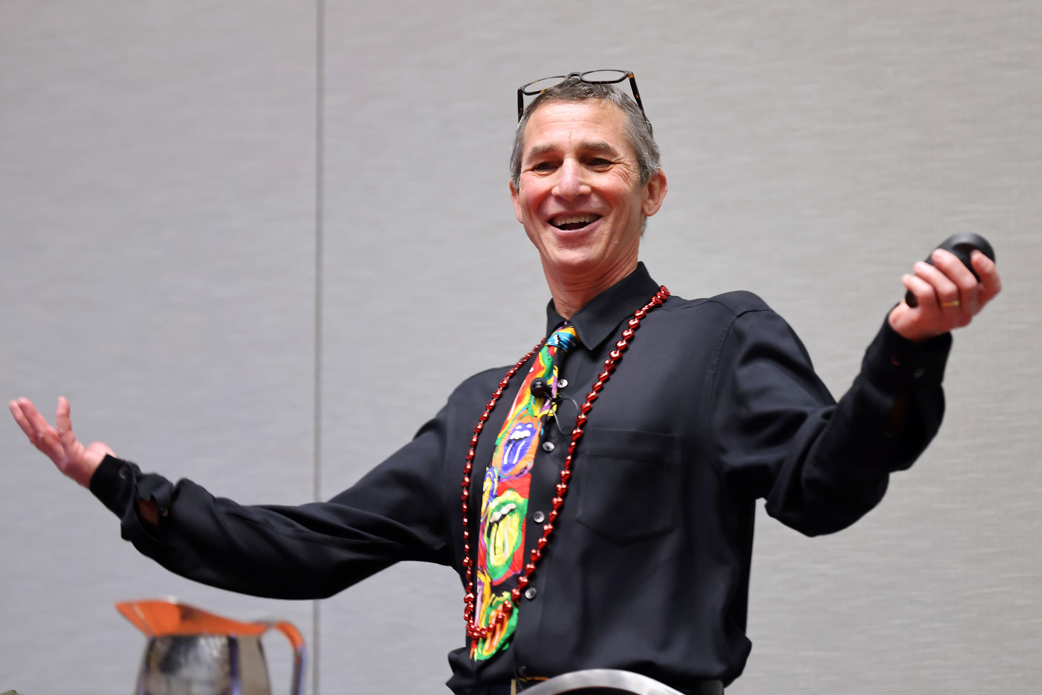
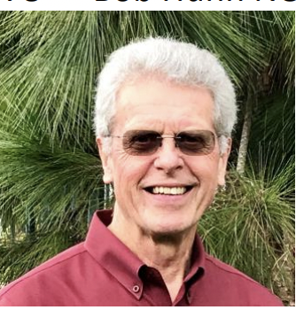
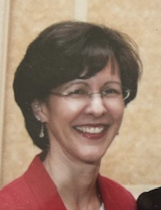
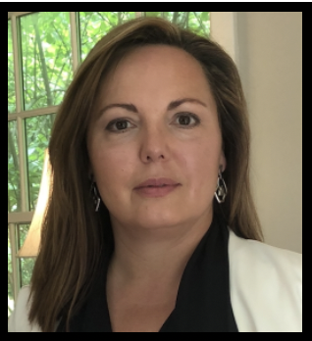
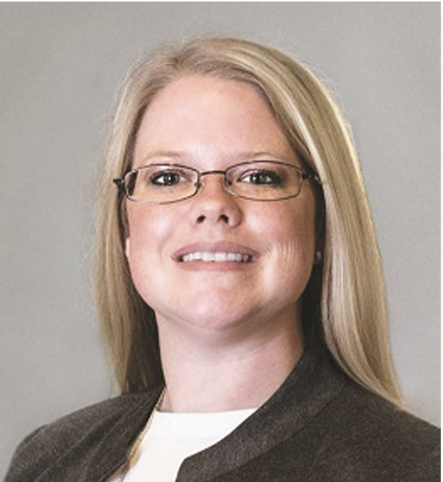
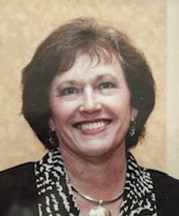
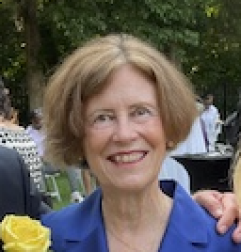
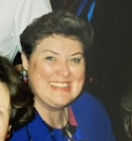
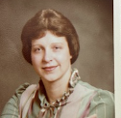
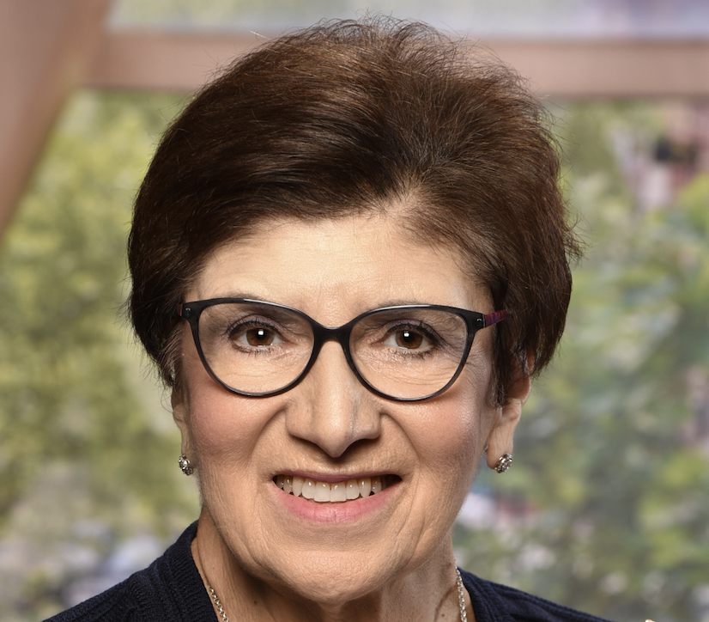
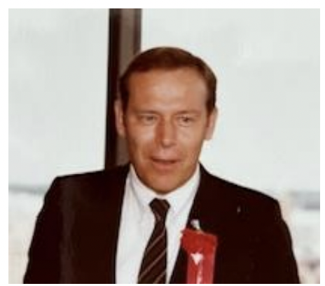
Presidents
50 Years of CV&P

Slide 4
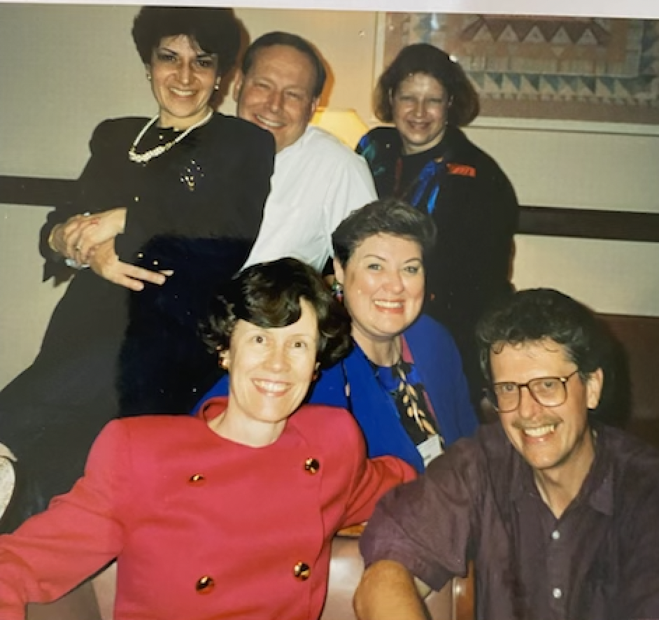
THE PRESIDENTS OF THE CARDIOPULMONARY SECTION FROM 1975 THROUGH 1990: SCOT IRWIN, BOB HUHN, COLLEEN KIGIN,
CATHY CERTO, DONNA FROWNFELTER
50 Years of CV&P

Slide 5
Colleen Kigin: 3rd President

Slide 6
Cathy Certo:
5th President

Slide 7
Steve Tepper: Past President of Cardiopulmonary Section

Slide 8
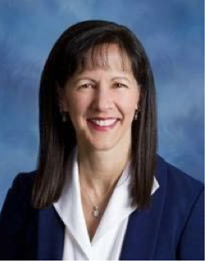
Dianne Jewell:
8th President

Slide 9
Ethel Frese: 9th President

Slide 10
Angela Campbell:
11th President

Slide 11
Vice Presidents
Bob Huhn Ellen Hillegass
Dave Nielsen Gary Brooks
Dave Hoeper Rebecca Crouch
Gail Robinson Paul Ricard
Donna Frownfelter Pam Bartlo
Morgan Johanson
50 Years of CV&P

Slide 12
Secretary
Terry Faye Ana Lotshaw
Marcia Pearl Marti Garlick
Carol Dickman Tammy Burlis
Rhonda Barr Kristin Lefebvre
Peg Pashkow Suzanne Greenwalt
Janet Waldmann Sagan Everett
50 Years of CV&P

Slide 13
Treasurers
Eileen Shepard Wendy Johnson
Richard Jensen Ethel Frehse
Robert Habesevich Ann Fick
Claudia Levenson Lauren Mellett
Alexandra Sciaky Mike Tevald
Susan Mihans
50 Years of CV&P

Slide 14
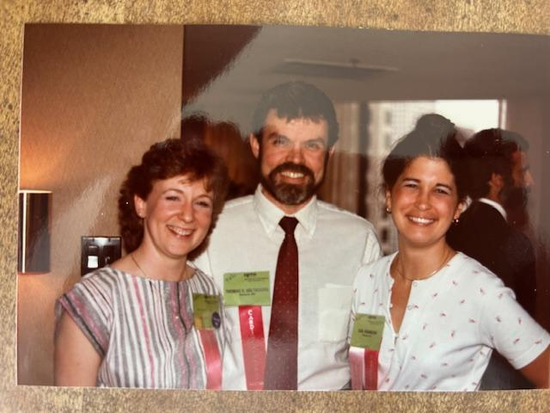
Past Executive Board: Rhonda Barr, Tom Habasevich, Gail Robinson
50 Years of CV&P

Slide 15
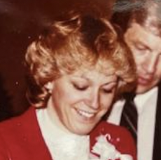
Quarterly/Record/CP Journal Editors
Cyndi Zadai
Steve Sakowsky
Sandy Cassady
Jane Eason
Ann Swisher
Sean Collins
Al Gurovich
50 Years of CV&P

Slide 16
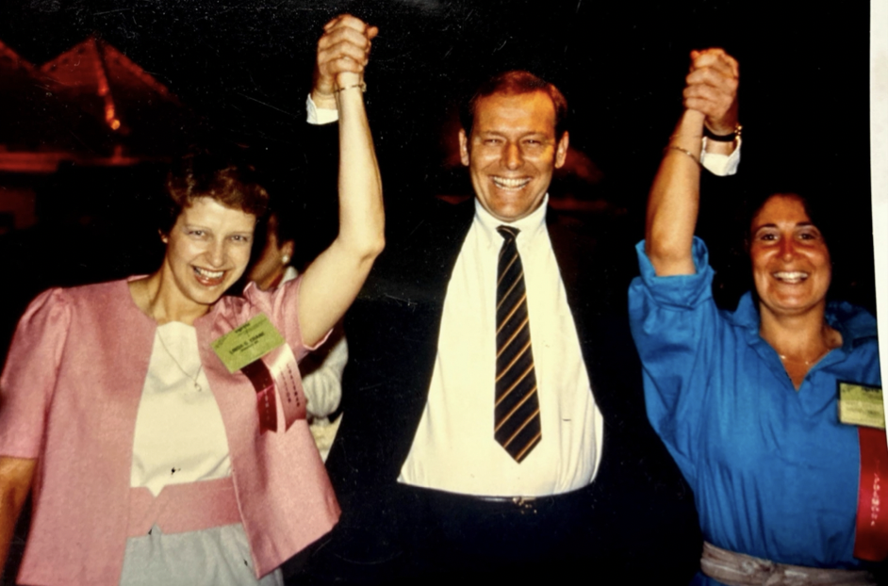
First Cardiopulmonary Clinical Specialists: Linda Crane, Scot Irwin, Meryl Cohen
50 Years of CV&P

Slide 17
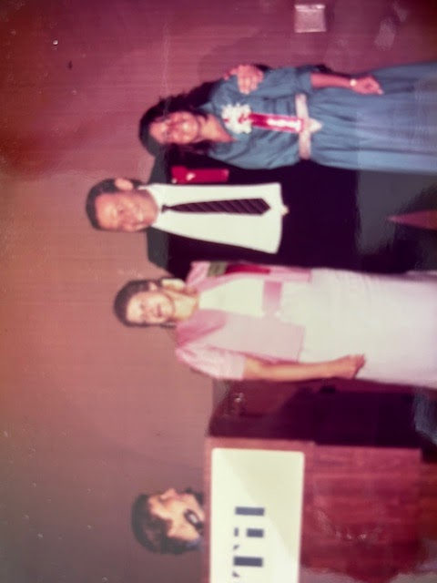
Treasurers
Scot Irwin
Linda Crane
Meryl Cohen
50 Years of CV&P

Slide 18
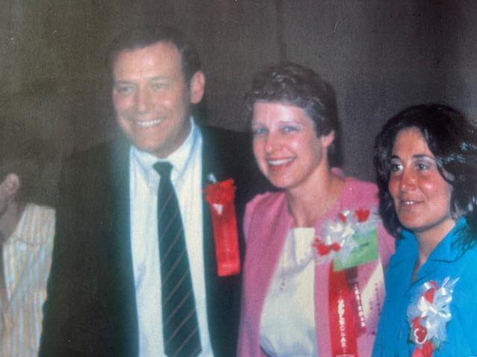
Celebrating 50 Years
Scot Irwin
Linda Crane
Meryl Cohen
50 Years of CV&P

Slide 19
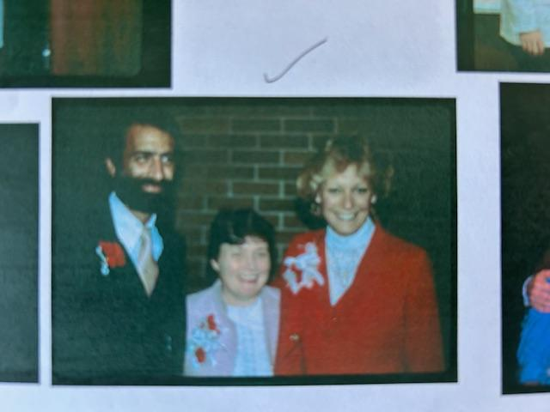
First Cardiopulmonary Specialty Council: Ray Blessey, Pam Catlin, Cyndi Zadai
50 Years of CV&P

Slide 20
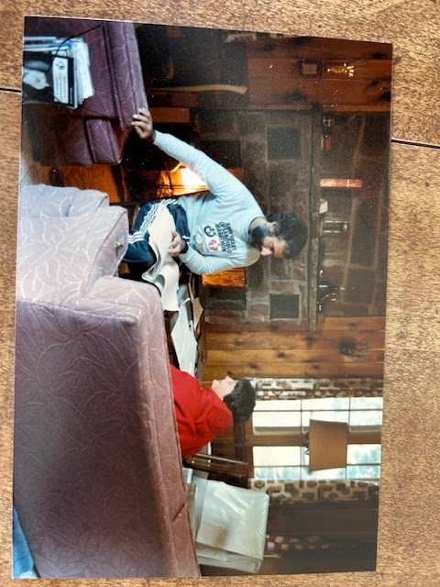
The Specialty Council hard at work: Ray Blessey and Pam Catlin
50 Years of CV&P

Slide 21
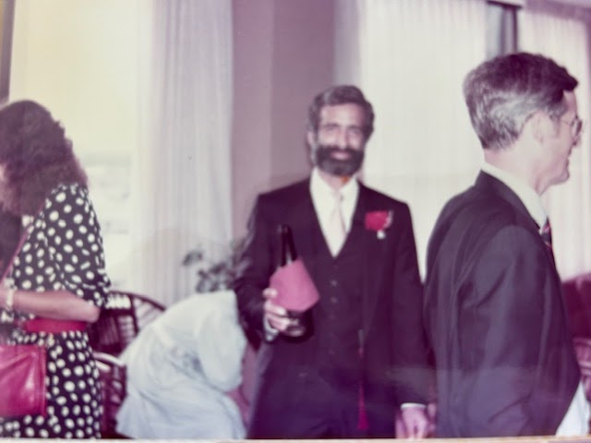
Ray Blessey: First Specialty Council Member
50 Years of CV&P

Slide 22
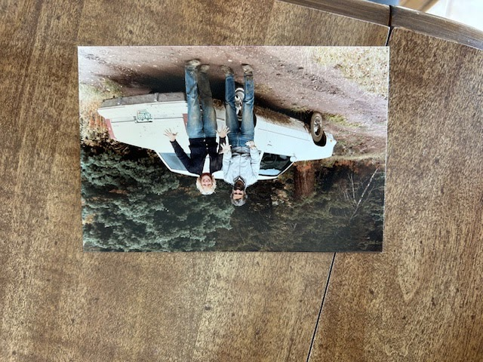
Ray Blessey and Cyndi Zadai: First Specialty Council Members
50 Years of CV&P

Slide 23
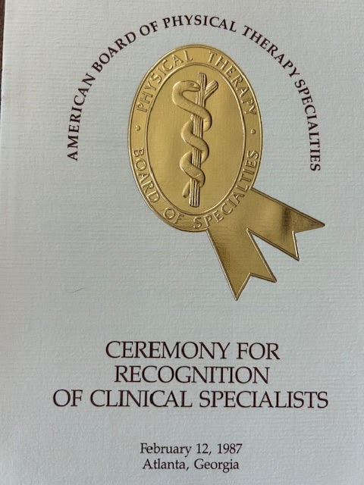
Award Ceremony Brochure
50 Years of CV&P

Slide 24
APTA Board Certified Cardiopulmonary Clinical Specialists THE FIRST 50
8-Steven Sadowsky
9-Sharon Elllis
10-Kate Grimes
11-Gail Hargrove
12-Joanne Watchie
13-Larry Cahalin
14-Andrew Cosentino
15-Terry Hoskins Michel
1-Scot Irwin
2-Linda Crane
3-Meryl Cohen
4-Susan Butler
5-Susan Garritan
6-Ellen Hillegass
7-Eugene McColgan
50 Years of CV&P

Slide 25
APTA Board Certified Cardiopulmonary Clinical Specialists THE FIRST 50
23-Lori Buck
24-Jacqueline Cannan
25-William Kuntz
26-Nancy Lee
27-Theresa Morrone
28-Kathy Lee Bishop
29-Gary Brooks
30-Hazel Dreyer
16-Alexandra Sciaky
17-Willliam Temes
18-William DeTurk
19-Kathleen Aldridge
20-Phyllis Krug
21-Stella Prevost
22-Randy Ice
50 Years of CV&P

Slide 26
APTA Board Certified Cardiopulmonary Clinical Specialists THE FIRST 50
31-Donna Frownfelter
31-John Greenwood
33-Anne Mejia-Downs
34-Gail Robinson
35-Adrienne Senneville
36-Helen Weston
37-Mary Bourgeois
38-Tammy Burlis
39-Almas Dossa
40-Martha Garlick
41-Dianne Jewell
42-Mark Lareau
43-Claudia Levenson
44-Rajashree Mondkar
45-Cynthia Zadai
46-Ronda Barr
47-Kathryn Bilik
48-Ethel Frese
49-Kris Ishii
50-Debra Parott
50 Years of CV&P

Slide 27
APTA Board Certified Cardiopulmonary Clinical Specialists 1985-2024
50 Years of CV&P

Slide 28
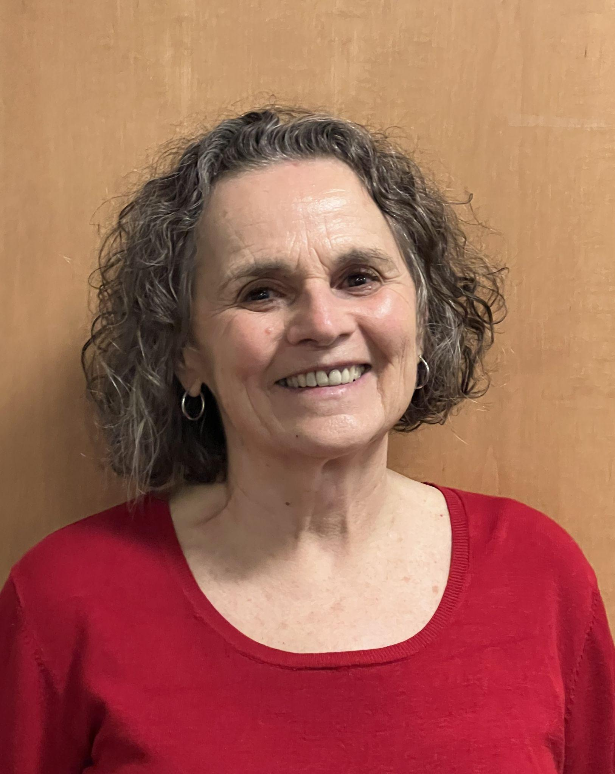
Kate Grimes, CCS #10
50 Years of CV&P

Slide 29
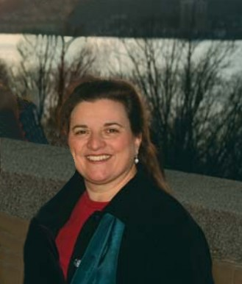
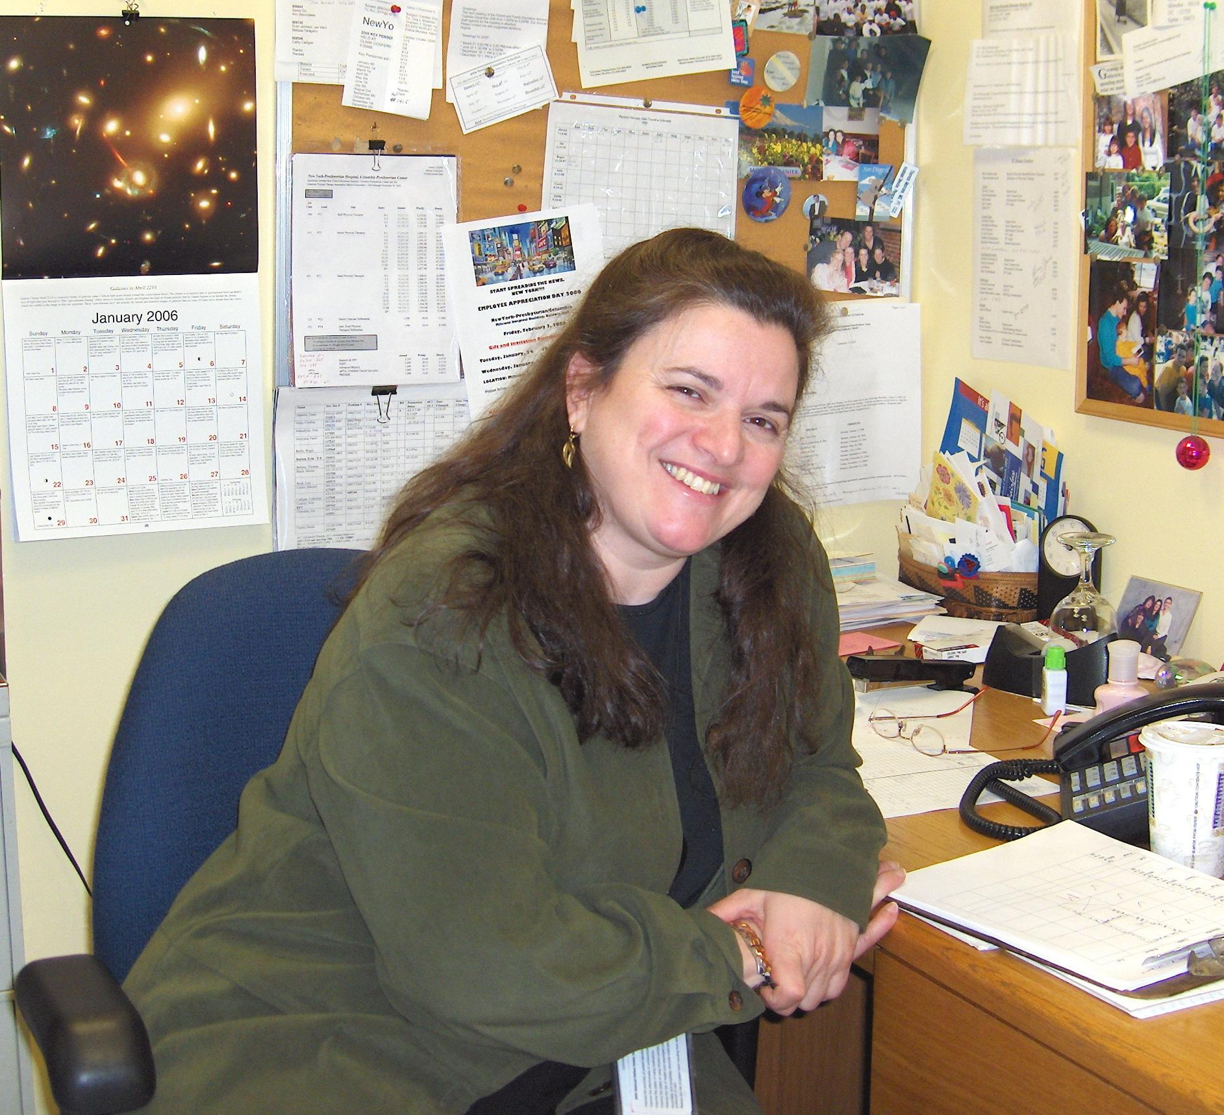
Theresa Morrone, CCS #27
50 Years of CV&P

Slide 30
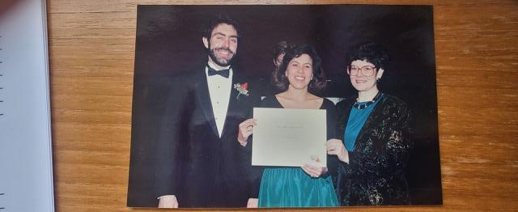
Anne Downs
50 Years of CV&P

Slide 31
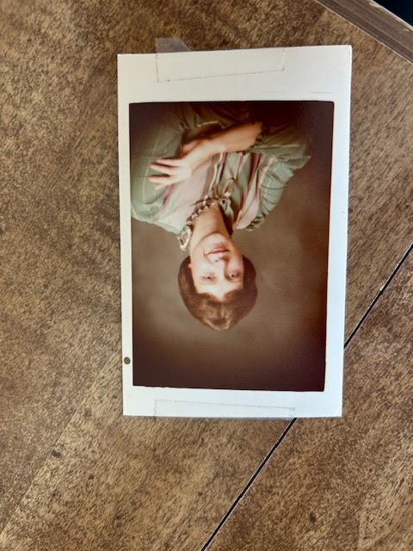
Linda Crane
50 Years of CV&P

Slide 32
Linda Crane Lectureship
2000 Meryl Cohen
2001 Nancy Ciesla
2002 Scot Irwin
2003 Susan Butler-McNamara
2004 Donna Frownfelter
2005 Carol Davis
2006 Martha Hinman
2007 Robert Huhn
2008 Ellen Hillegass
2009 Mary Massery
2010 Sherrill Hayes
2011 Venita Lovelace-Chandler
2012 Larry Cahalin
2013 Sandra Cassady
2014 Dianne Jewell
2015 Ethel Frese
2016 Julie Ann Starr
2017 Anne Mejia-Downs
2018 Sean Collins
2019 Elizabeth Dean
2020 Anne Swisher
2021 Christiane Perme
2022 Steve Tepper
2023 Ann Fick
2024 Alvaro Gurovich
2025 Rebecca Crouch
2026 Dan Malone
50 Years of CV&P

Slide 33
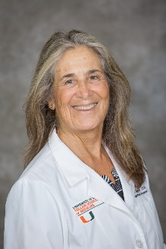
Meryl Cohen…FIRST Linda Crane Lecturer

Slide 34
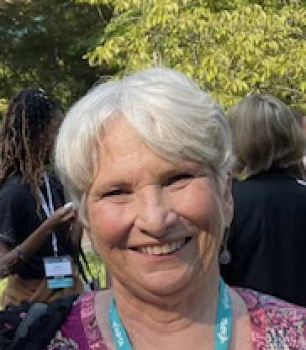
Nancy Ciesla
Second Linda Crane Lecturer

Slide 35
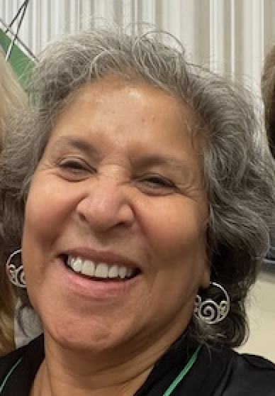
Anne Mejia Downs
Linda Crane Lecturer on Resilience

Slide 36
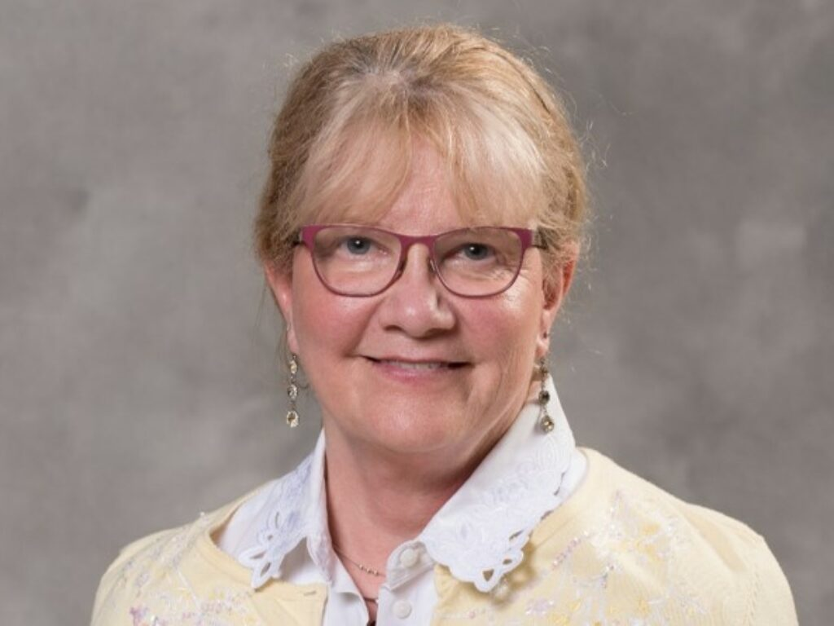
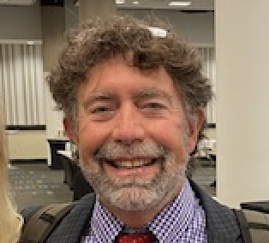
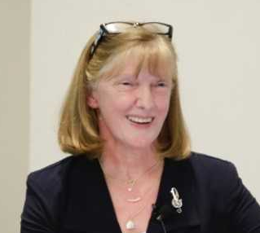
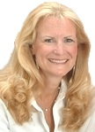
Linda Crane Award Recipients
2025 Linda Crane
50 Years of CV&P

Slide 37
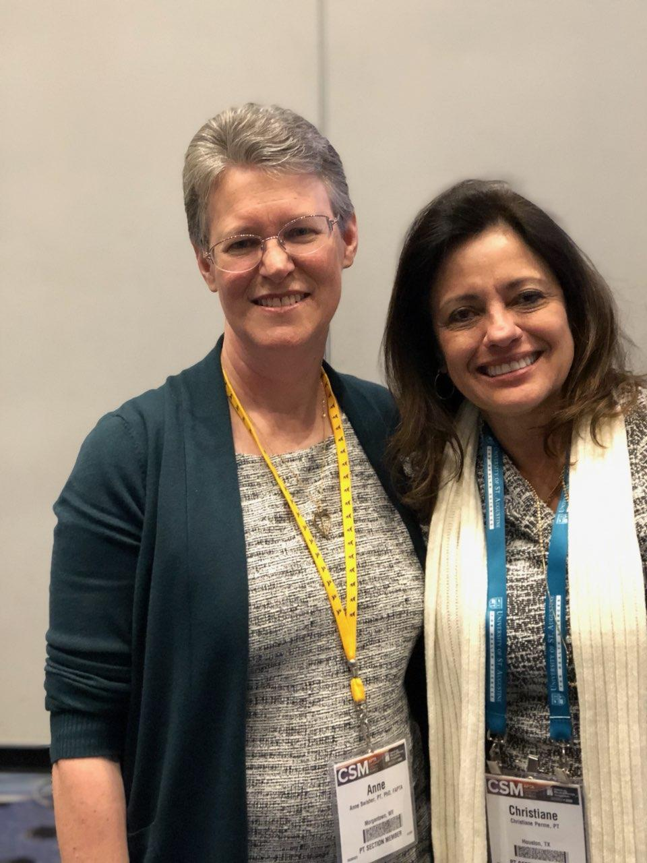
Ann Swisher and Chris Perme
50 Years of CV&P

Slide 38
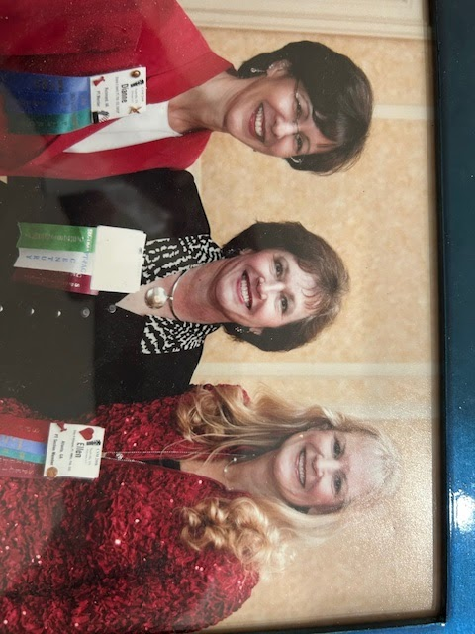
Linda Crane Lecture: Ellen Hillegass with Dianne Jewell and Ethel Frese
50 Years of CV&P

Slide 39
Academy Merit Award Recipients
2025 Angela Campbell
2024 Jennifer Sharp & John Connell
2023 Ashley Poole
2022 Morgan Johanson
2021 Chris Wells
2020 Joe Adler
2019 Richard Gach
2018 Chris Wells
2017 Pam Bartlo
2016 Kristin Lefebvre
2015 Ann Fick
2014 Dawn Stackowicz
2013 Christine Wilson
2011 Ethel Frese, Bobby Belarmino
2010 Anne Swisher
2009 Dan Malone
2008 Jane Eason
2007 Alexandra Sciaky
2006 Dianne Jewell
2005 Mike LaMothe
2003 H. Steven Sadowsky
2002 Tamara Burlis
2001 Tanya LaPier
2000 June Marble
1999 Jane Wetzel
1998 Steve Tepper
1997 Sue Mihans, Alexandra Sciaky
1996 Susan Butler-McNamara
1995 Sandra Cassady
1994 Bill Temes
1993 Larry Cahalin
1992 Catherine Certo
1991 Ellen Hillegass
1990 Joanne Watchie
1989 Linda Crane
1988 Donna Frownfelter
1987 Bob Huhn, Marcia Pearl
1985 Cynthia Zadai, Ray Blessey,
Pam Caitlin
1984 Colleen Kigin
1983 Scot Irwin
50 Years of CV&P

Slide 40
Academy Mentor Award
2025 Stephanie Kostsuca
2024 Bryan Lohse
2023 Traci Betts
2022 Melissa Bednarek
2022 Kathy Lee Bishop
2021 Meryl Cohen
2020 John Lowman
2019 Michael Shoemaker
2018 Gail Huber
2017 Alex Sciaky
2016 Paul Ricard
2015 Christiane Perme
2014 Neeti Pathare
2013 Rebecca Crouch
2011 Dianne Jewell
2010 Annie Downs
2009 Donna Frownfelter
2008 Colleen Kigin
2007 David Nelson
50 Years of CV&P

Slide 41
APTA Catherine Worthingham Fellows
2022 Mary J. Sinott, PT, DPT, MEd, FAPTA
2022 Lisa D. VanHoose, PT, MSPT, PhD, MPH, FAPTA
2021 Lawrence P. Cahalin, PT, PhD, FAPTA
2021 Nancy Ciesla, PT, DPT, FAPTA
2019 Julie Ann Starr
2018 Ethel Frese
2016 Steve Tepper, Anne Swisher, Patricia Hageman
2014 Meryl I. Cohen
2012 Ellen Hillegass
2008 Colleen Kigin, Elizabeth Protas, Jane K. Sweeney
2007 Charles Cicone, Claire Peel, Lucinda Pfalzer
2003 Catherine Certo
2001 Cynthia Zadai
* 1990 Marilyn Moffat
50 Years of CV&P

Slide 42
Lucy Blair Award Recipients
2022 Angela Campbell PT, DPT
2022 Holly Clynch, PT DPT, MA
2022 Ann Fick, PT, DPT, MS
2021 John D. Heick, PT, DPT, PhD
2021 Marilyn E. Miller, PT, PhD
2021 George Stephen Morris, PT, PhD
2021 Michael James Shoemaker, PT, DPT, PhD
2019 Ethel Frese
2016 George Coggeshall
2013 Steve Tepper
2007 Dianne Jewell
1999 Patricia McAdoo
1996 Catherine Certo
1994 Scot Irwin
1992 Linda Crane, Cynthia Zadai
1983 Colleen Kigin
50 Years of CV&P

Slide 43
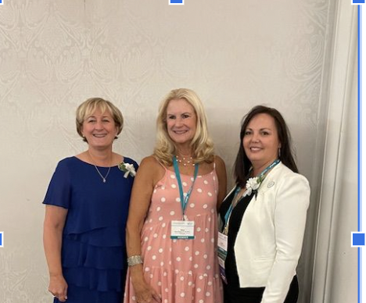
2022 Angela Campbell and Ann Fick received Lucy Blair Award
50 Years of CV&P

Slide 44
Celebrating 50 Years
Teaching Cardiopulmonary In Other Countries
2017: Ellen Hillegass and Steve Tepper in KENYA teaching at Kenyatta Institute
50 Years of CV&P

Slide 45
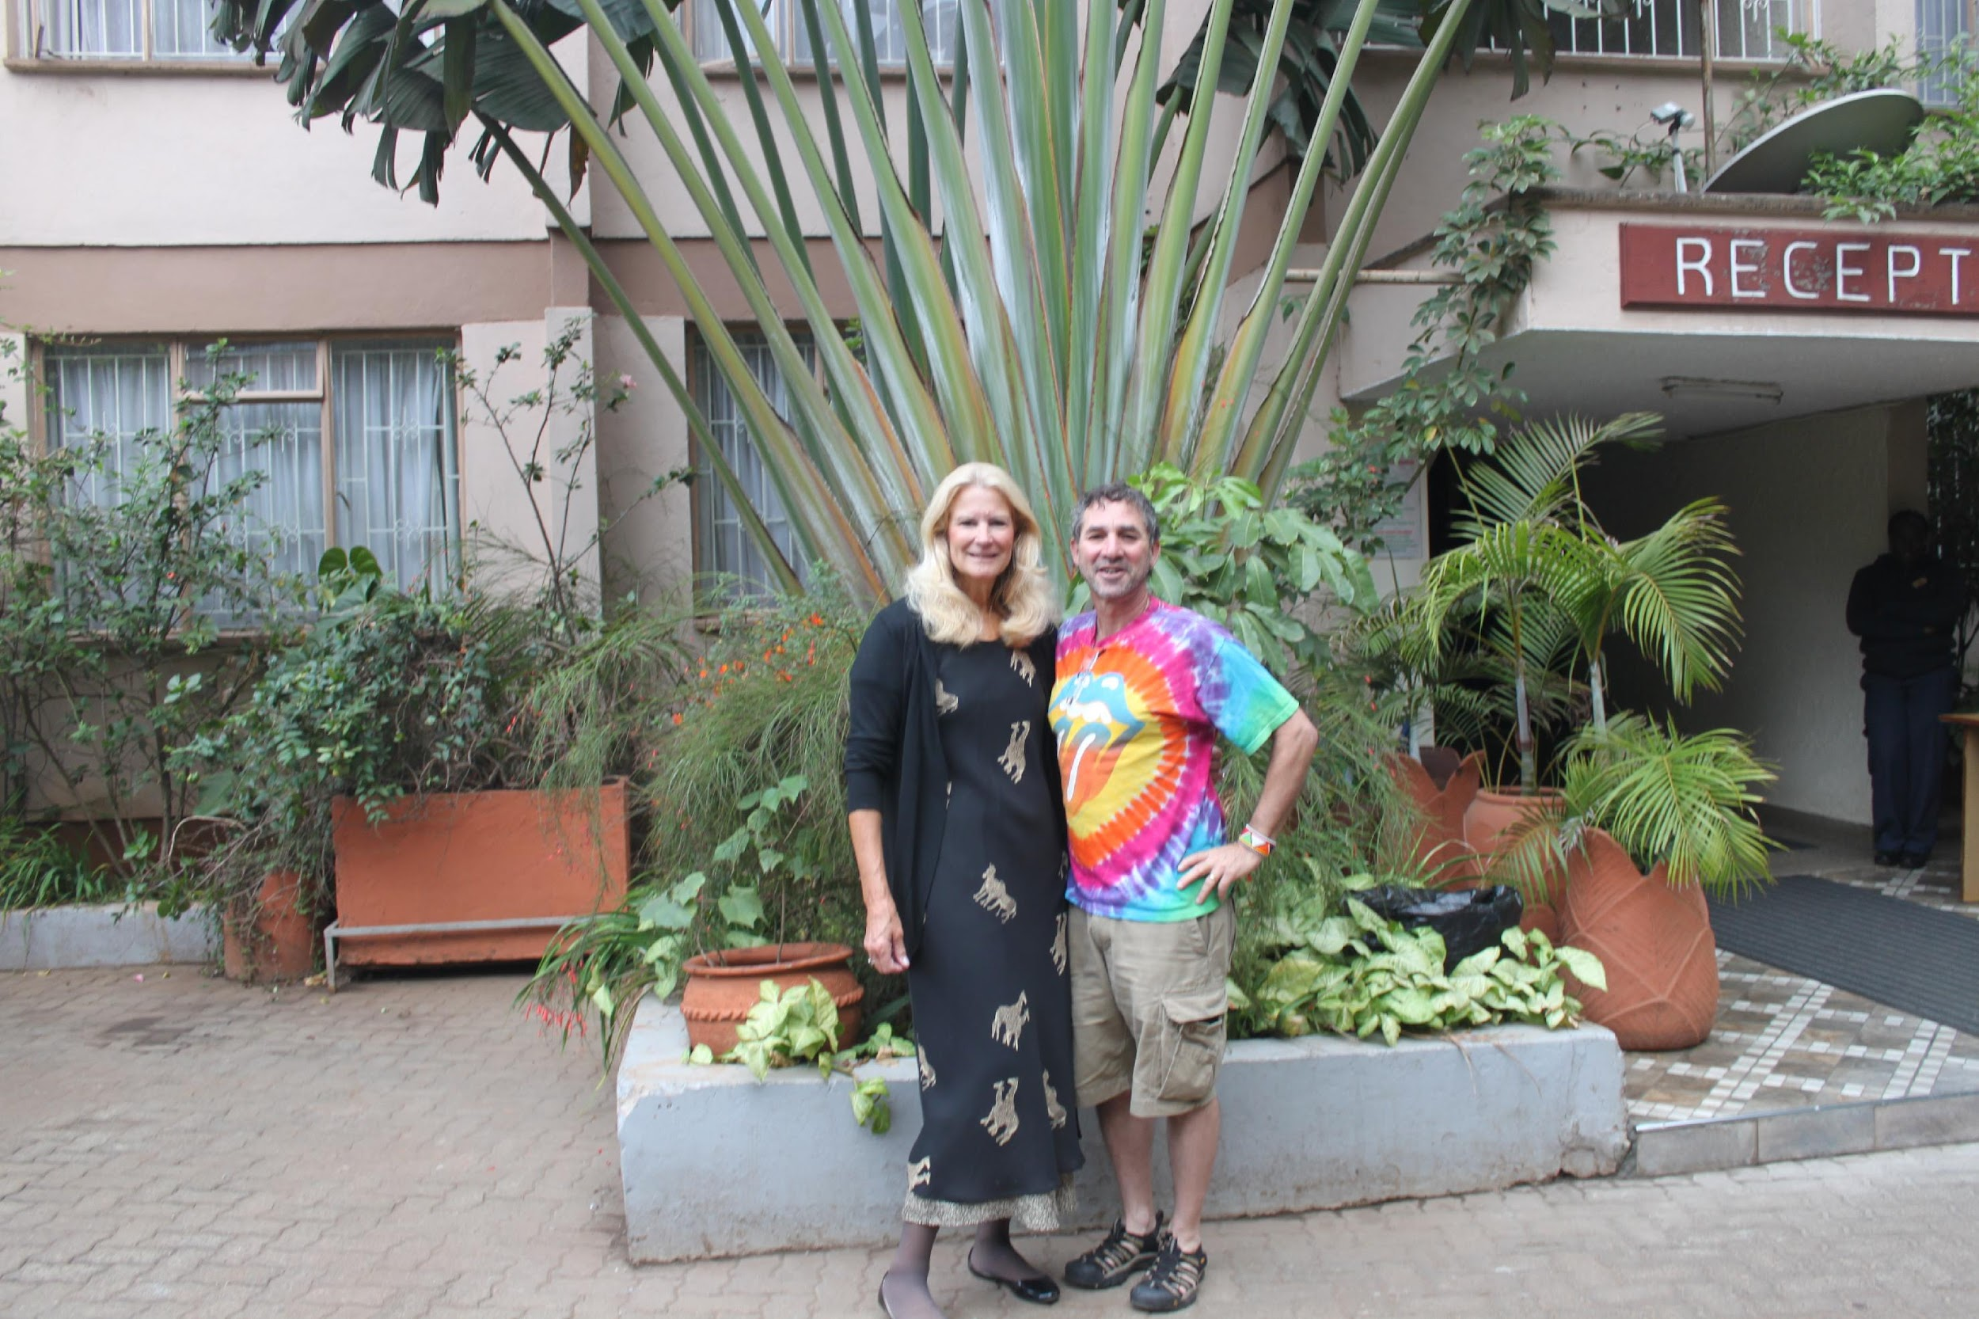
Celebrating 50 Years
2017: Ellen Hillegass and Steve Tepper in KENYA teaching at Kenyatta Institute
50 Years of CV&P

Slide 46
Celebrating 50 Years
Steve Tepper and Ellen Hillegass providing BP cuffs and pulse oximeters to the Kenyatta Institute from the Jackson Clinics 2017
50 Years of CV&P

Slide 47
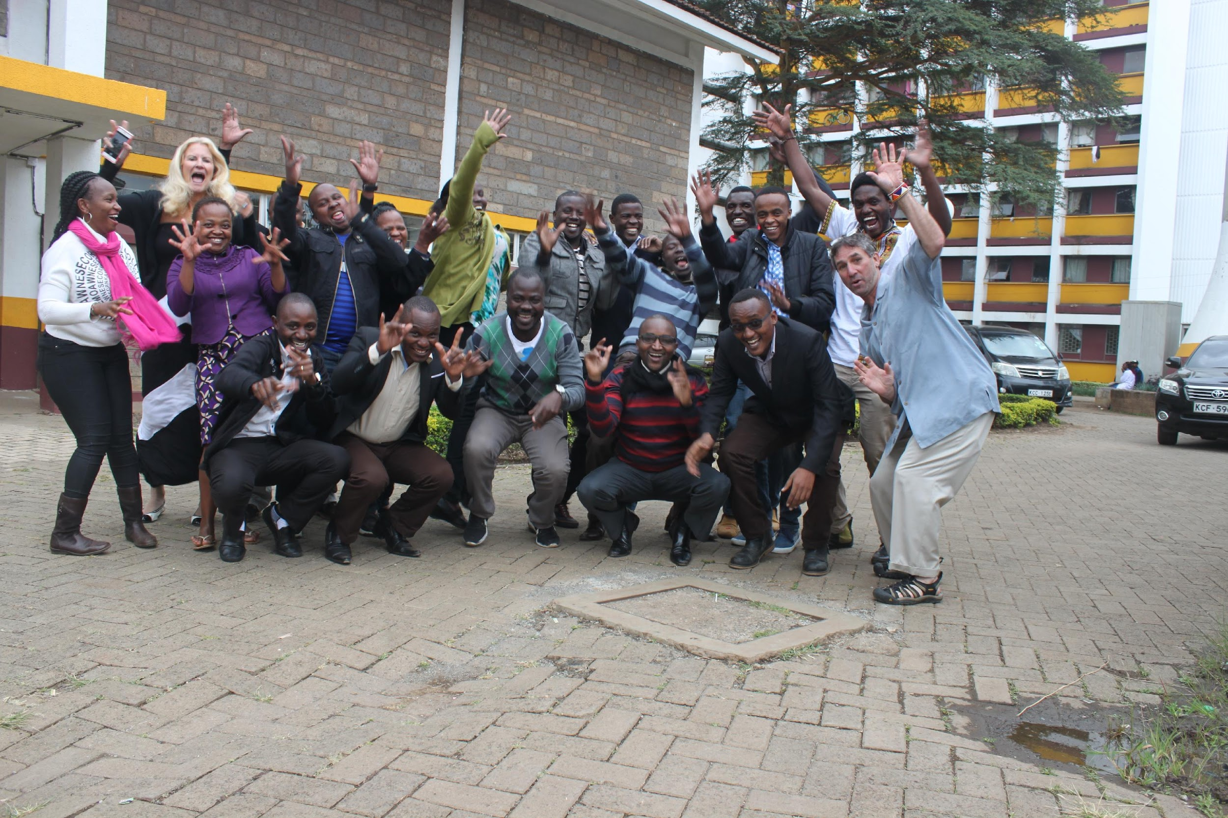
Celebrating 50 Years
Steve Tepper and Ellen Hillegass taught the Bachelors Students at Kenyatta Institute in Kenya in 2017.
50 Years of CV&P

Slide 48
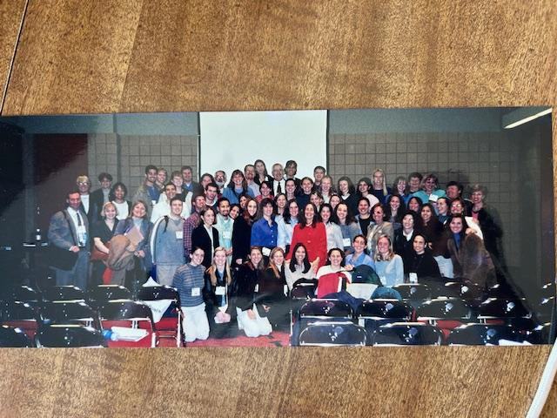
Treasurers
50 Years of CV&P

Slide 49
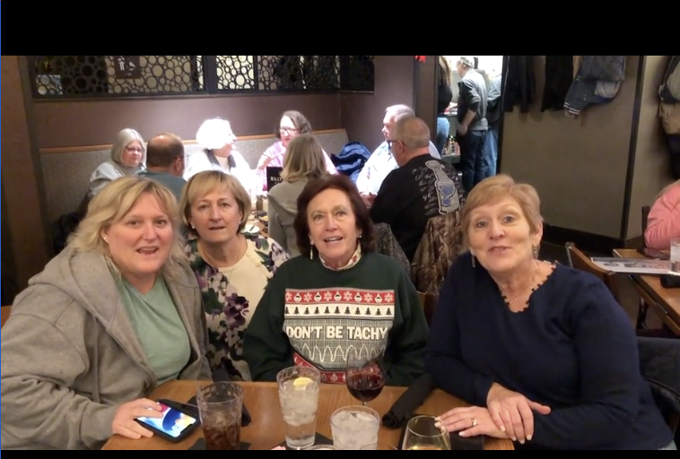
The FAB FOUR: Heidi Tymkew, Ann Fick, Ethel Frese, Tammy Burlis
50 Years of CV&P

Slide 50
First Annual Conference
First Annual Conference which took place September 2023
in Atlanta
50 Years of CV&P

Slide 51
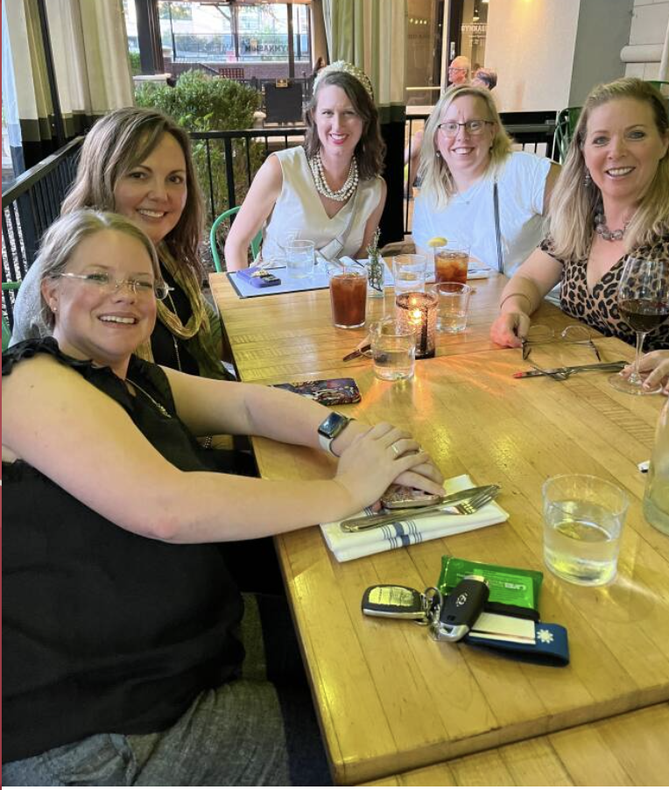
First Annual Conference
First Annual Conference which took place September 2023 in Atlanta
Conference Committee Members:
Jenny Sharp, Rebecca Gage, Morgan Johanson with President Angela Campbell and Ashley Parish
50 Years of CV&P

Slide 52
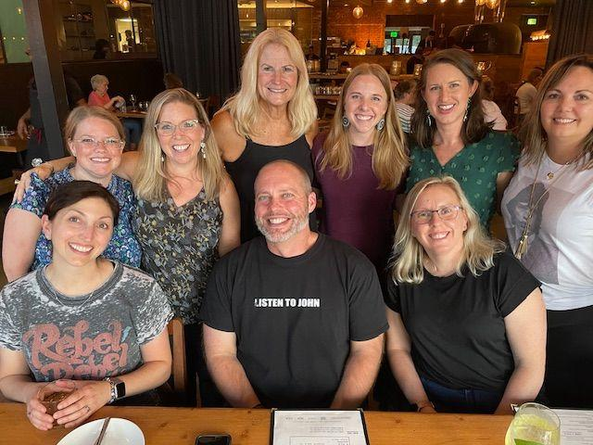
Conference Committee
50 Years of CV&P

Slide 53
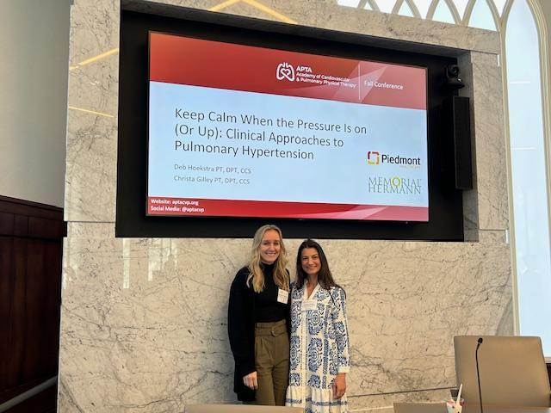
First Annual Conference
Deb Hoekstra and Christa Bauer
50 Years of CV&P

Slide 54
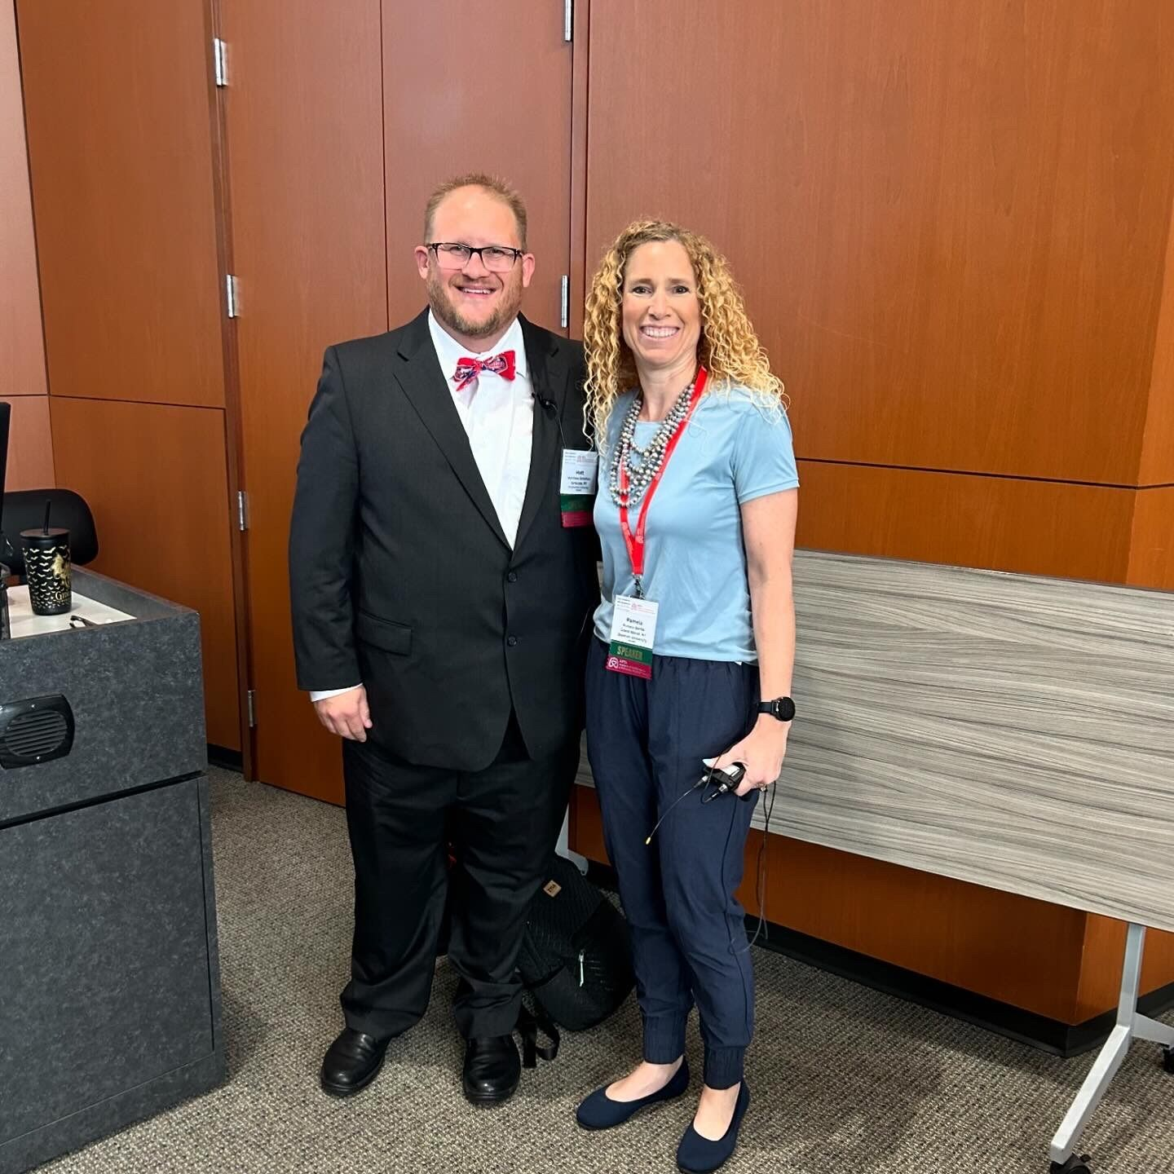
Matt Bowman and Pam Bartlo
50 Years of CV&P

Slide 55
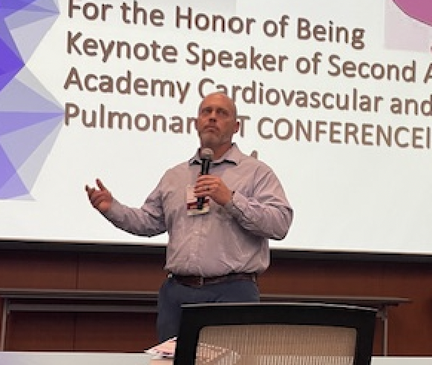
John Connell: Education Chair/Annual Conference Chair
50 Years of CV&P

Slide 56
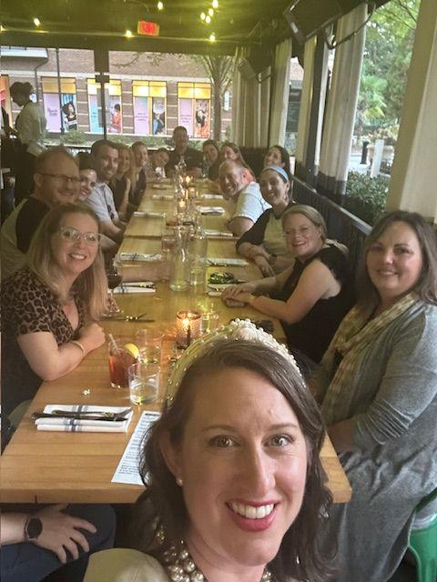
50 Years of CV&P

Slide 57
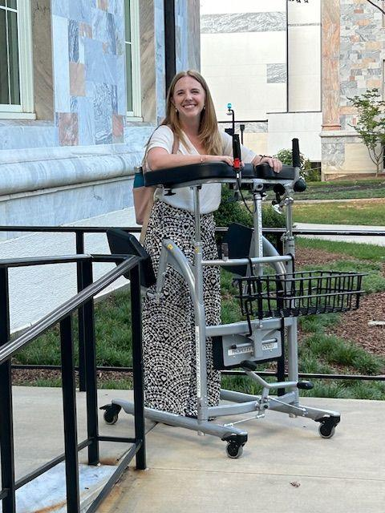
Katelyn Whitlock
50 Years of CV&P

Slide 58
Second Annual Conference
50 Years of CV&P

Slide 59
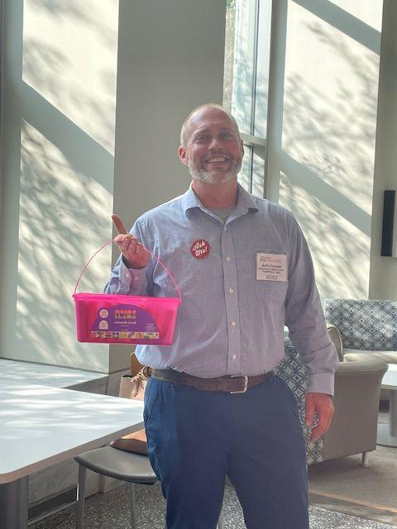
John Connell: Conference Chair
50 Years of CV&P

Slide 60
Sean Lowers and Karlyn Green
50 Years of CV&P

Slide 61
50 Years of CV&P

Slide 62
Pam Bartlo, Talia Pollok, Julie Skrzat
50 Years of CV&P

Slide 63
New Keynote Award at Annual Conference
50 Years of CV&P

Slide 64
Traci Betts and Brooke Wilson
50 Years of CV&P

Slide 65
Second Annual Conference: Conference Committee
50 Years of CV&P

Slide 66
50 Years of CV&P

Slide 67
Mike Puthoff
50 Years of CV&P

Slide 68
Second Annual Conference: Traci Betts and Haley Bento
50 Years of CV&P

Slide 69
50 Years of CV&P

Slide 70
50 Years of CV&P

Slide 71
Residencies
Duke University, Durham, NC: First CVP Residency
Ann Arbor VA, Ann Arbor, MI
Brigham Womens, Boston MA
Madison VA, Madison WI
Mercer/Piedmont Hospital, Atlanta, GA
UT Southwestern, Dallas, GA
University of Miami, Miami FL
University of Michigan, Ann Arbor MI
The Ohio State University, Columbus, OH
University of Utah, Salt Lake, UT
Cedars-Sinai, Los Angeles, CA
Cincinnati VA, Cincinnati, OH
St Louis VA and Maryville College, St Louis, MO
West Virginia University
50 Years of CV&P

Slide 72
Residency Case Studies
50 Years of CV&P

Slide 73
Our Members Throughout the Years
50 Years of CV&P

Slide 74
Ethel Frese and Rebecca Crouch
50 Years of CV&P

Slide 75
Angela Campbell, Nancy Smith, Morgan Johanson, Sagan Everett, Pam Bartlo
50 Years of CV&P

Slide 76
Pam Bartlo and Dawn Stachawicz
50 Years of CV&P

Slide 77
Paul Ricard and Pam Bartlo
50 Years of CV&P

Slide 78
Dan Malone and Ethel Frese
50 Years of CV&P

Slide 79
50 Years of CV&P

Slide 80
Angela Campbell and Dan Malone
50 Years of CV&P

Slide 81
Rachel Pata, Pam Bartlo, Julie Skrzat
50 Years of CV&P

Slide 82
Our Executive Director: Edward Mathis
50 Years of CV&P

Slide 83
Morgan Johanson, Ellen Hillegass, Kayla Black teaching Pre Con at CSM
50 Years of CV&P

Slide 84
Morgan Johanson and Christa Bauer
50 Years of CV&P

Slide 85
50 Years of CV&P

Slide 86
The Bubbles Group
50 Years of CV&P

Slide 87
Besties
50 Years of CV&P

Slide 88
Jenny Sharp, Morgan Johanson, Ashley Parish
50 Years of CV&P

Slide 89
50 Years of CV&P

Slide 90
50 Years of CV&P

Slide 91
50 Years of CV&P

Slide 92
50 Years of CV&P

Slide 93
50 Years of CV&P

Slide 94
50 Years of CV&P

Slide 95
50 Years of CV&P

Slide 96
50 Years of CV&P

Slide 97
50 Years of CV&P

Slide 98
50 Years of CV&P

Slide 99
50 Years of CV&P

Slide 100
50 Years of CV&P

Slide 101
50 Years of CV&P

Slide 102
50 Years of CV&P

Slide 103
50 Years of CV&P

Slide 104
40th Anniversary
50 Years of CV&P

Slide 105
50 Years of CV&P

Slide 106
50 Years of CV&P

Slide 107
50 Years of CV&P

Slide 108
50 Years of CV&P

Slide 109
50 Years of CV&P

Slide 110
50 Years of CV&P

Slide 111
50 Years of CV&P

Slide 112
10 year anniversary of Specialization
50 Years of CV&P

Slide 113
Treasurers
Meryl Cohen:
Please Autograph my Program
50 Years of CV&P

Slide 114
Treasurers
Jan Techlin
50 Years of CV&P

Slide 115
Treasurers
50 Years of CV&P

Slide 116
Mike Shoemaker, Crystal Gluch
50 Years of CV&P

Slide 117
Residencies
50 Years of CV&P

Slide 118
Residencies
50 Years of CV&P

Slide 119
Crystal Gluch and Stephanie Kostsuca in Virtual Photo Booth
50 Years of CV&P

Slide 120
Academy of Cardiopulmonary
Social at CSM 2024

Slide 121
Mike Shoemaker and Crystal Gluch
50 Years of CV&P

Slide 122
Morgan Johanson, Alex Sciaky, Crystal Gluch, Stephanie Kostsuca,
50 Years of CV&P

Slide 123
Residencies
New Catherine Worthingham Fellows:
Larry Cahalin
Nancy Ciesla with
Meryl Cohen
50 Years of CV&P

Slide 124
Centennial Celebration 2021 Ellen Hillegass, Dianne Jewell, Angela Campbell
50 Years of CV&P

Slide 125
Award Ceremony Reception 2021: Larry Cahalin (Fellow), Colleen Kigin (Mary McMillan Lecture)
50 Years of CV&P

Slide 126
Award Ceremony Reception 2021: Ashley Parish, Larry Cahalin, Meryl Cohen, Mariangel Cahalin, Ellen Hillegass
50 Years of CV&P

Slide 127
Ashley Parish (Emerging Leader Award, Nancy Ciesla (Fellow Award), Larry and Mariangel Cahalin (Larry: Fellow). Stanley Paris, Meryl Cohen, Ellen Hillegass, Catherine Paris (Fellow)
Award Ceremony Reception 2021
50 Years of CV&P

Slide 128
Centennial Celebration in Washington DC Dianne Jewell, Michael Shoemaker, Larry and Mariangel Cahalin, Crystal Gluch, Ellen Hillegass, Angela Campbell
50 Years of CV&P

Slide 129
Centennial Celebration in Washington DC Michael Shoemaker, Crystal Gluch, Ellen Hillegass, Steve Tepper, Larry and Mariangel Cahalin, Angela Campbell
50 Years of CV&P

Slide 130
Residencies
50 Years of CV&P

Slide 131
Residencies
50 Years of CV&P

Slide 132
Ellen Hillegass, Meryl Cohen working on Investigating History
50 Years of CV&P

Slide 133
Celebrating 50 Years
50 Years of CV&P

